Slide 1



Val/Galentines Day Spotify Keychain Workshop
2.10.2025

Slide 2
Schedule
6:30—7:30pm Customize your keychains on Adobe Illustrator
@ 2nd floor (here!) benchtop computers
7:30—8:30pm Engrave/cut out keychains on wood or acrylic
@ 1st floor (downstairs) laser cutting room

Slide 3
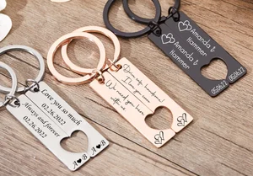
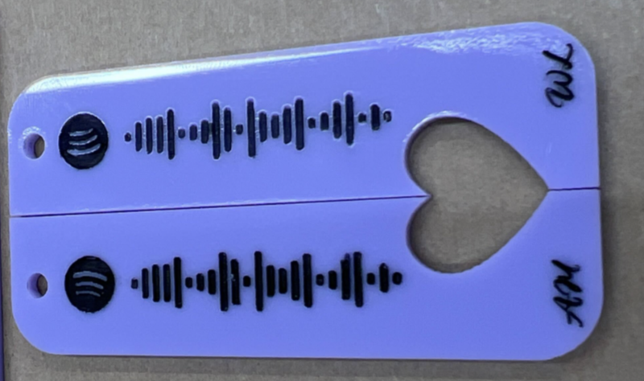
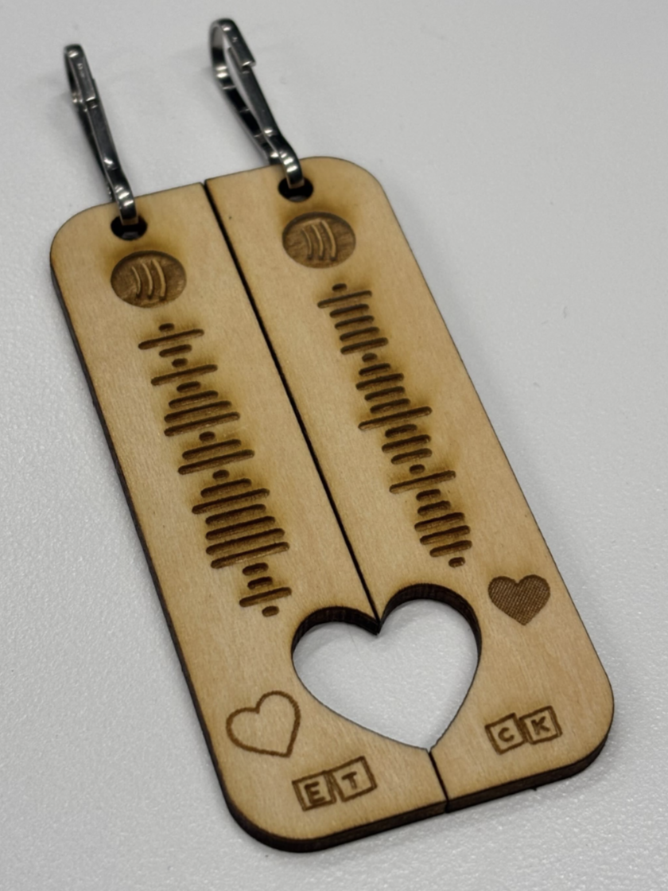
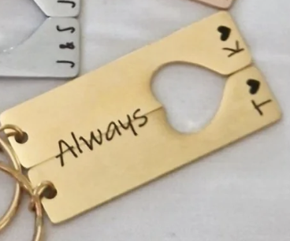
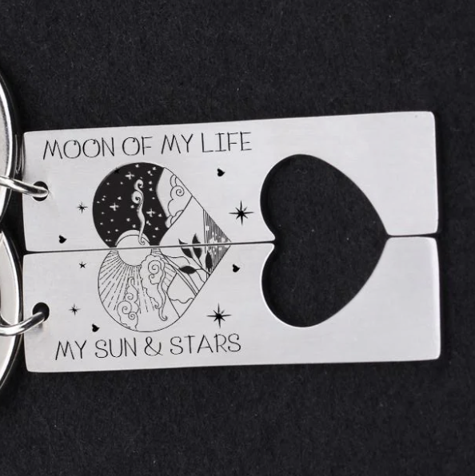
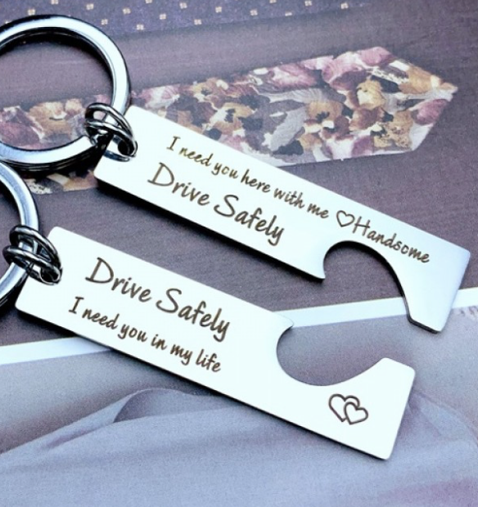
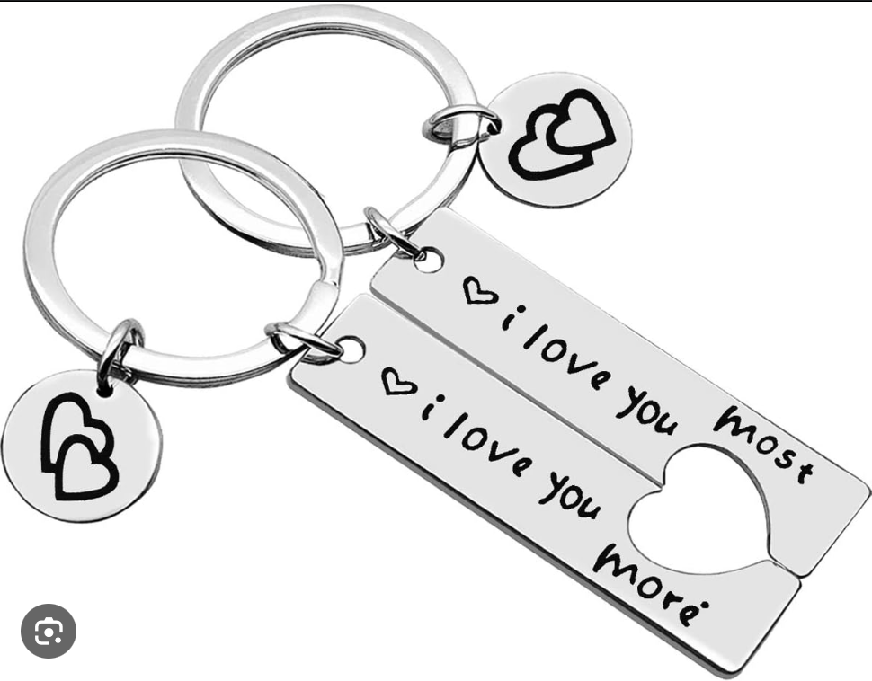
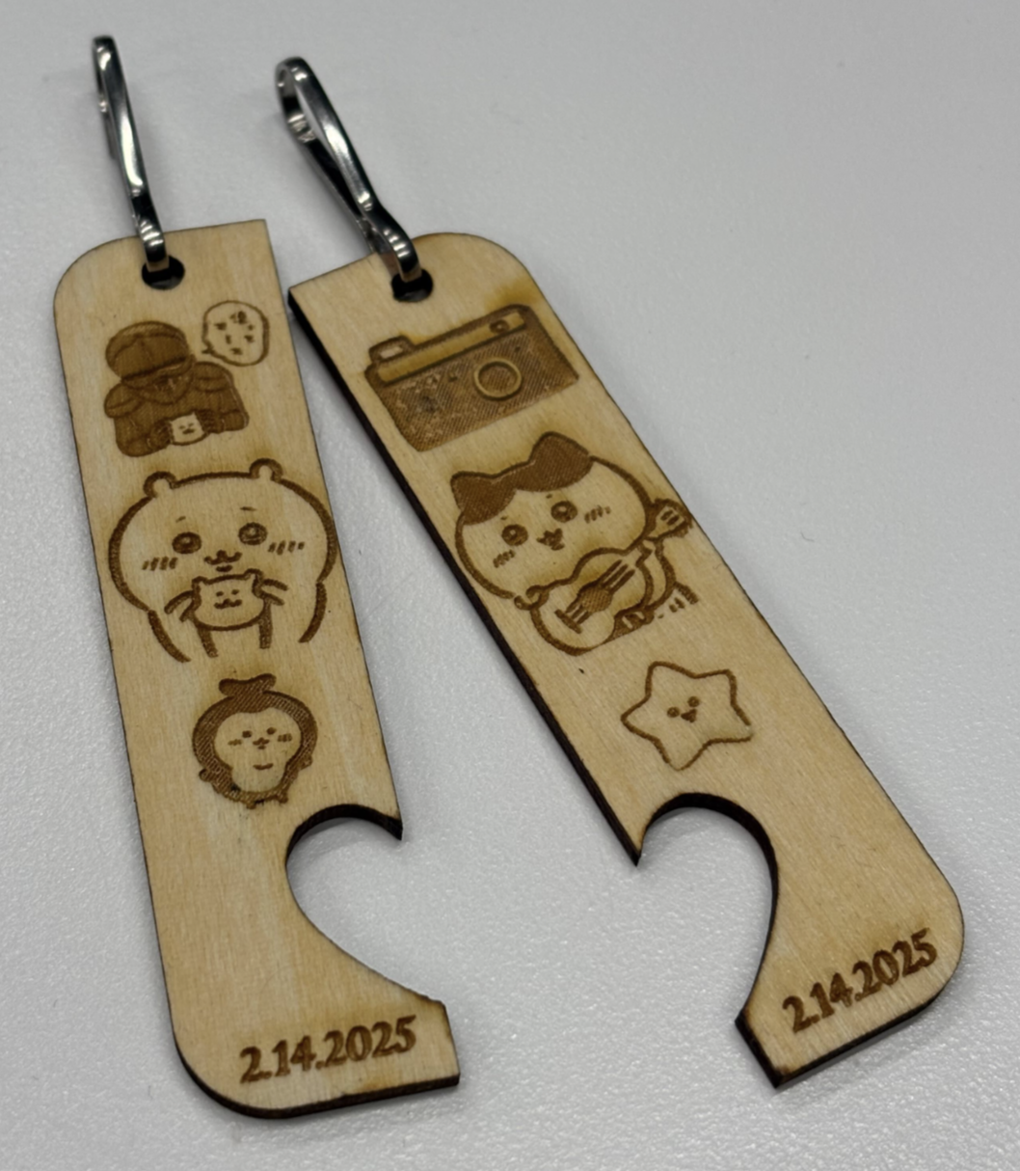
Inspo Pics & Examples

Slide 4
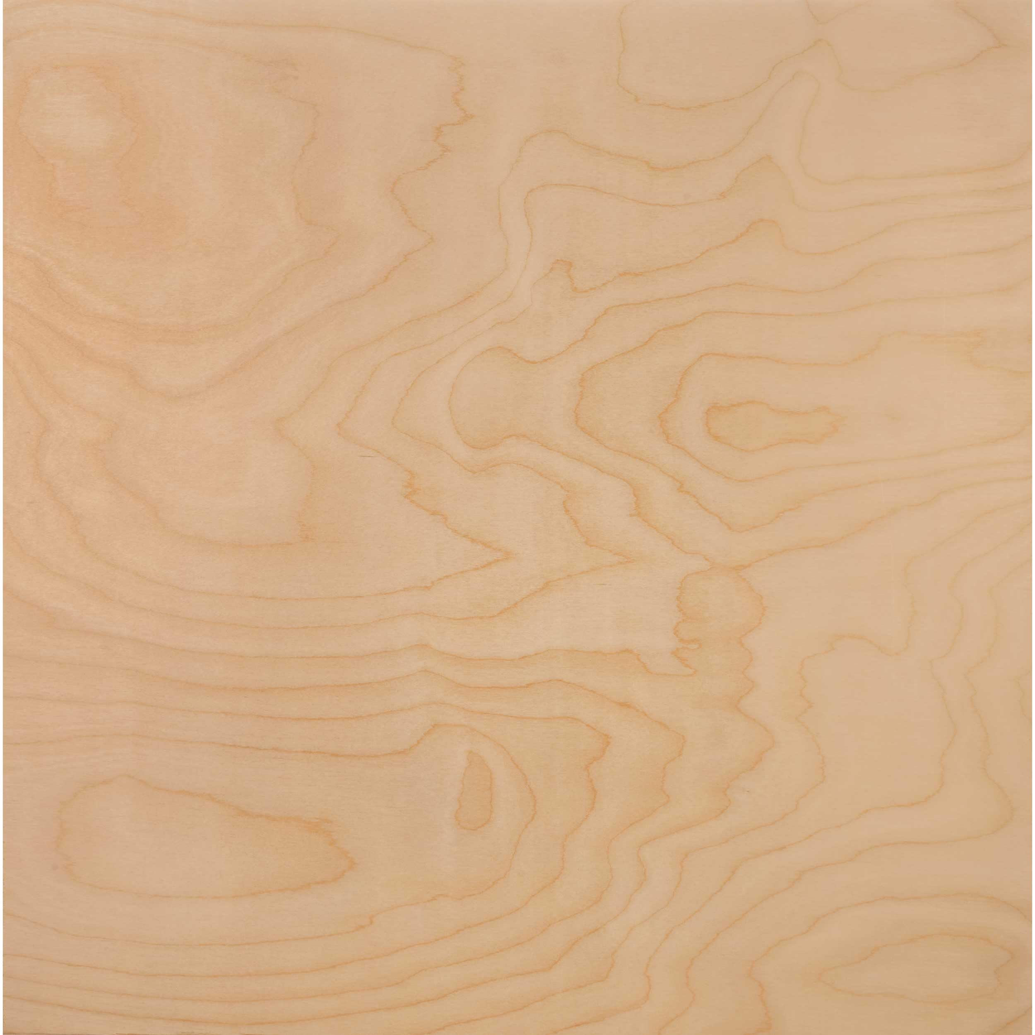

Material Options
Wood
Clear
Grey
Magenta
Red
Orange
Yellow
Green
LightBlue
DarkBlue
LightPurple

Slide 5
Directions
1. Go to spotifycodes.com
Google “[Artist] [SongTitle] Spotify”
“…” -> “Share” -> “Copy Song Link”
Paste link -> “Get Spotify Code”
Background: #FFFFFF (white)
Bar color: black
Format: SVG
2. Open SVG file in Adobe Illustrator
Click on the white background, & delete
Drag-select Spotify logo & code -> right-click -> select “Group”
Set width to 1.8inches (keep aspect ratio), then rotate 270°
Copy Spotify code group
3. Open spotify-front-back-template.ai
Paste Spotify code to front keychain(s)
Customize front and/or back with text or images!
4. Save file to a USB as:
Spotify-[YourName]-[MaterialColor].ai
Wood
Clear
Black
Grey
Magenta
Red
Orange
Yellow
Green
LightBlue
DarkBlue
LightPurple
Notes:
https://tinyurl.com/3fytpudm

